Slide 1
UNMANNED AERIAL VEHICLE FOR DISASTER MANAGEMENT RESCUE AND CRIME DETECTION
PROJECT SUPERVISOR:
Ms.Suruthi S
Assistant Professor
Group No: 13
By:
Allwin Meshach Hezron T 310620106012
Bhuvaneshwaran L 310620106021

Slide 2
OUTLINE
OBJECTIVES
INTRODUCTION
PROPOSED METHODOLOGY
BLOCK DIAGRAM
HARDWARE REQUIREMENTS
EXPECTED OUTCOMES
CONCLUSION
REFERENCES – PEER REVIEWED JOURNALS ONLY

Slide 3
OBJECTIVES
The objective of this project is to create an advanced, comprehensive, and highly effective security and rescue system based on image processing.
This system aims to significantly enhance safety across the entire area or unit space by providing real-time surveillance, person tracking, and monitoring capabilities.

Slide 4
INTRODUCTION
A unmanned arial vehicle or UAV with networking capabilities is described.
Normal UAVs uses RF Signal Transmitter for movements, transmitter range must be big to ensure satisfactory range in searching.
This RF system was removed and a novel use of Path Planning Algorithms allowed a series of improvements to be made.
The UAV's core capabilities include autonomous flight planning using GPS navigation, on-board image capture, and seamless data transmission to a central server through GSM connectivity.
To add a layer of intelligence to the system, machine learning algorithms are incorporated, enabling the UAV to operate in three distinct modes.

Slide 5
LITERATURE SURVEY
S.NO | JOURNAL DETAILS | TECHNIQUES USED | INFERENCE
1. | Pantic, M., & Patras, I. (2006). Dynamics of facial expression: recognition of facial actions and their temporal segments from face profile image sequences. IEEE Transactions on Systems, Man and Cybernetics, Part B (Cybernetics), 36(2), 433–449. doi:10.1109/tsmcb.2005.859075 | Auxiliary Particle Filtering | Automating the analysis of facial signals, especially rapid facial signals
2. | Teuliere, C., Marchand, E., & Eck, L. (2015). 3-D Model-Based Tracking for UAV Indoor Localization. IEEE Transactions on Cybernetics, 45(5), 869–879. doi:10.1109/tcyb.2014.2337652 I | Multiple hypotheses registration and particle filtering | 3-D Model-Based Tracking for UAV Outdoor Localization
3. | Araujo, P., Fontinele, J., & Oliveira, L. (2019). Multi-Perspective Object Detection for Remote Criminal Analysis Using Drones. IEEE Geoscience and Remote Sensing Letters, 1–4. doi:10.1109/lgrs.2019.2940546 | YOLO-v3, to identify and classify objects of interest in the scene | A drone to sweep scenes with criminal evidences

Slide 6


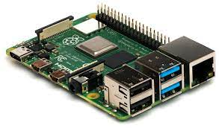


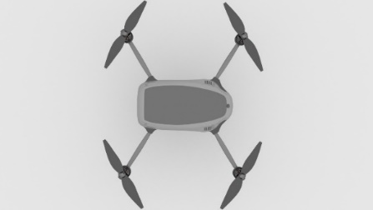

BLOCK DIAGRAM
Search for any device connection
Reports to local authorities
Raspberry Pi
Feeding data/pictures about missing person
Server
Local Storage

Slide 7
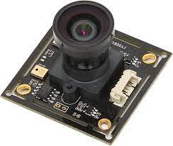
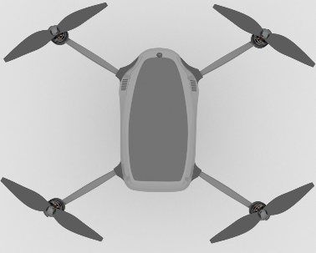
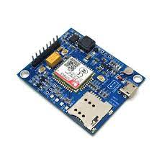
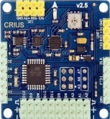
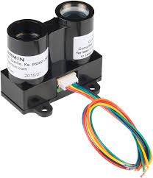
BLOCK DIAGRAM
High Resolution Camera Module
Raspberry Pi
GSM & GPS module
UAV
LIDAR sensors

Slide 8
PROPOSED METHODOLOGY
Clearly define the problem you're addressing: developing an automated UAV system for efficient search and rescue missions and crime detection.
Gather relevant data for lost persons (if available) and crime statistics in the targeted areas.
Create an algorithm to determine the optimal UAV deployment location based on the last known location of the person.
Integrate an advanced autopilot system capable of autonomous flight, obstacle avoidance, and adaptive flight path planning.
Integrate GSM, GPS, and LTE modules for seamless communication and data sharing.
Choose appropriate uncrowded or high-crime areas for UAV deployment based on crime data.
Define thresholds and criteria for identifying potential crimes and emergencies.

Slide 9
HARDWARE REQUIREMENTS
Components | Price
1x Flight Controller | ₹2000
4x BLDC motors | ₹2000
4x Electronic Speed Controllers | ₹2000
4x Propeller Blades | ₹500
1x Raspberry Pi 3 | ₹4000
1x Camera Module | ₹3000
4x LIDAR sensors | ₹1000
1x 14.4 volt Rechargeable LiPo Battery | ₹1500
1x UAV Frame | ₹800
1x Battery Management System | ₹200
1x GSM module | ₹300
1x First Aid Kit | ₹300
1x Battery Charger | ₹150
1x 6 Channel RF Rx & Tx | ₹4000

Slide 10
TIMELINE
TIMELINE | PROCESS
August - September 2023 | Research and Planning Hardware Selection and Assembly
October - December 2023 | Software Development and Flight Testing
January 2024 – February 2024 | Autonomous Flight Testing
February 2024 - April 2024 | Sending the gathered data and applying machine learning
April 2024 | Performance Optimization and Refinement Documentation and Publishing

Slide 11
EXPECTED OUTCOMES
Rapid Assessment and Situational Awareness
Search and Rescue Operations
Hazardous Environment Exploration
Remote Monitoring and Communication
Data Collection and Analysis
Enhanced Decision-Making
Reduced Risk to Human Responders
Improved Resource Allocation
Public Safety and Community Engagement

Slide 12
CONCLUSION
Focused on analyzing LTE values for network coverage within a single cell, utilizing a Line-Of-Sight (LOS) radio propagation model. Notably, we achieved this by removing the RF controller from the UAV, leading to promising outcomes. The obtained level of accuracy holds significant potential, especially for rescue services. Nevertheless, it is important to acknowledge that potential errors might arise in regions characterized by limited visibility and higher moisture level

Slide 13
REFERENCES
https://www.sciencedirect.com/science/article/abs/pii/B9780128202760000133
https://ieeexplore.ieee.org/document/9214241
https://www.sciencedirect.com/science/article/abs/pii/S1084804522001370

Slide 14


